Slide 1
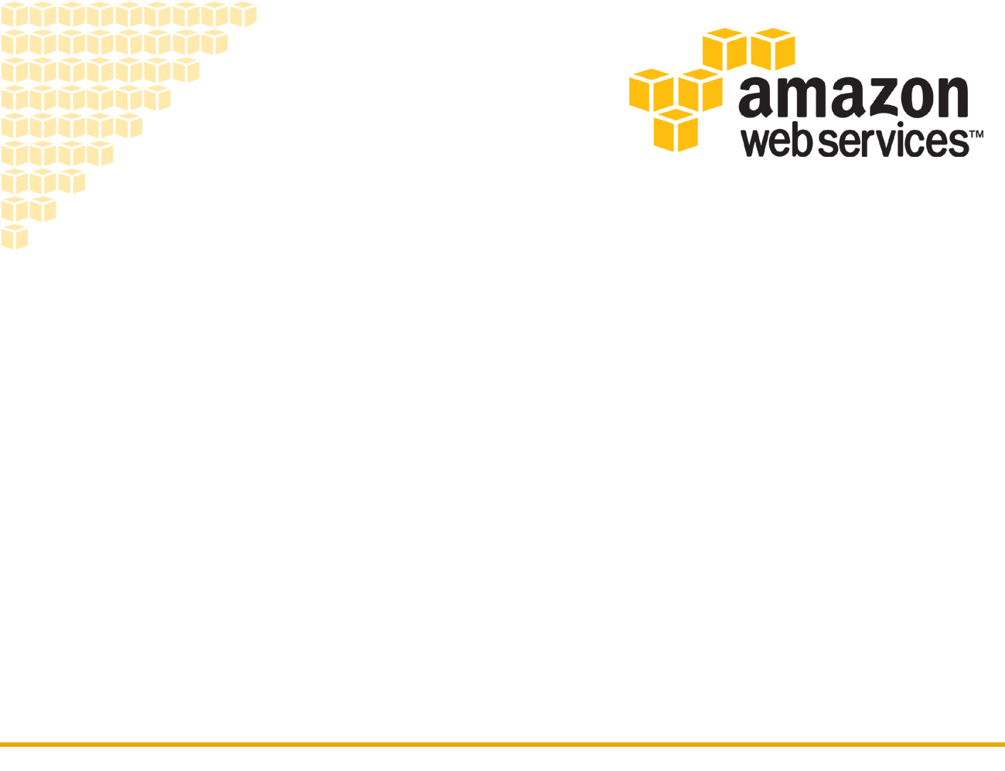
Amazon Elastic Compute Cloud (EC2)

Slide 2
Introduction
Provides scalable computing capacity in the Amazon Web Services (AWS) cloud.
Can use EC2 to launch as many or as few virtual servers as you need, configure security and networking, and manage storage.
Enables you to scale up or down to handle changes in requirements or spikes in popularity, reducing your need to forecast traffic.
Windows, Linux most common operating systems

Slide 3
Features
Virtual computing environments, known as instances
Preconfigured templates for your instances, known as Amazon Machine Images (AMIs)
AMI package the bits you need for your server (including the operating system and additional software)
Various configurations of CPU, memory, storage, and networking capacity for your instances, known as instance types
Secure login information for your instances using key pairs
Temporary storage volumes (Instance store volumes) and permanent storage volumes (Amazon EBS )
Multiple physical locations (Regions & Availability Zones)

Slide 4
Features
A firewall that enables you to specify the protocols, ports, and source IP ranges that can reach your instances using security groups
Static IP addresses for dynamic cloud computing, known as Elastic IP addresses
Metadata, known as tags, that you can create and assign to your Amazon EC2 resources
Virtual networks you can create that are logically isolated from the rest of the AWS cloud, and that you can optionally connect to your own network, known as virtual private clouds (VPCs)
AWS features a wide selection of commercial and free softwares from well known vendors, designed to run on your EC2 instances.

Slide 5
AMI
AMI is a template that contains a software configuration (OS, Appln. Server, Software etc)
Provides the information required to launch an instance
AMI includes the following:
A template for the root volume for the instance (for example, an operating system, an application server, and applications)
Launch permissions that control which AWS accounts can use the AMI to launch instances
A block device mapping that specifies the volumes to attach to the instance when it's launched

Slide 6
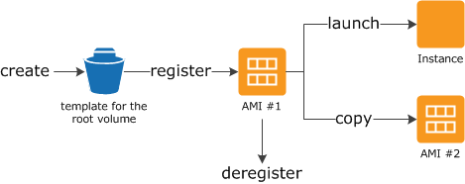
AMI lifecycle

Slide 7
AMI
Can customize the instance that you launch from a public AMI and then save that configuration as a custom AMI for your own use.
After creating an AMI, can keep it private or share it with a specified list of AWS accounts. Can also make the custom AMI public so that the community can use it.
You can purchase an AMIs from a third party, including AMIs that come with service contracts from organizations such as Red Hat.
You can also create an AMI and sell it to other Amazon EC2 users.
Once Deregistered, an AMI can't be used to launch new instances.
It is important to keep AMI up to date

Slide 8
Instances
Instances are virtual computing environments
provides a wide selection of instance types optimized to fit different use cases.
All backed by Intel microprocessors
Instance type comprising of various combinations of CPU, memory, storage and networking capacity
General Purpose (T2, M4, M3)
Compute Optimized (C4, C3)
Memory Optimized (X1, R3)
Accelerated Computing Instances (P2, G2)
Storage Optimized (I2-High I/O, D2-Dense Storage)
For More info: https://aws.amazon.com/ec2/instance-types/

Slide 9
Instances
EC2 is integrated with other AWS services like
Amazon Elastic Block Store (EBS)
Amazon Cloud Watch
Amazon Virtual Private Cloud (VPC)
AWS Identity and Access Management (IAM)

Slide 10
Instance types
Instance type that we specify determines the hardware of the host computer used for your instance.
Amazon EC2 provides each instance with a consistent and predictable amount of CPU capacity, regardless of its underlying hardware.
EC2 dedicates some resources of the host computer, such as CPU, memory, and instance storage, to a particular instance.
Other resources of the host computer like network and the disk subsystem are shared among instances.

Slide 11
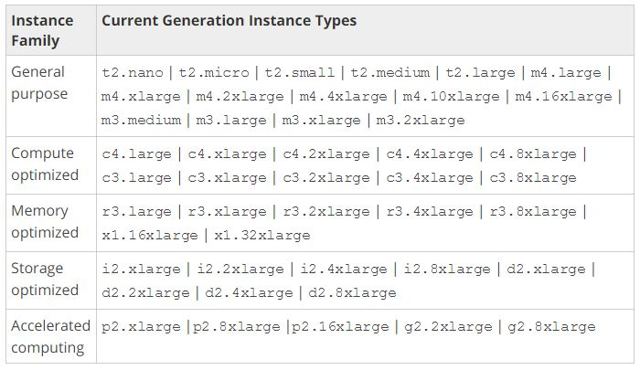

Slide 12
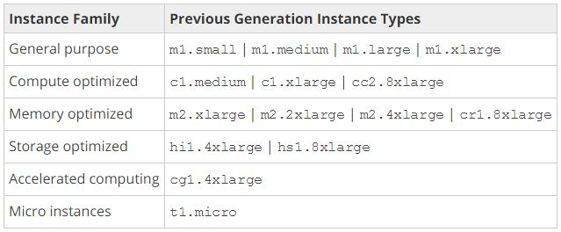

Slide 13
Instance purchasing options
On-Demand instances — Pay, by the hour, for the instances that you launch.
Reserved Instances — Purchase, at a significant discount, instances that are always available, for a term from one to three years.
Scheduled Instances — Purchase instances that are always available on the specified recurring schedule, for a one-year term.
Spot instances — Bid on unused instances, which can run as long as they are available and your bid is above the Spot price, at a significant discount.
Dedicated hosts — Pay for a physical host that is fully dedicated to running your instances, and bring your existing per-socket, per-core, or per-VM software licenses to reduce costs.
Dedicated instances — Pay, by the hour, for instances that run on single-tenant hardware.

Slide 14
Instance lifecycle
The lifecycle of an instance starts when it is launched and ends when it is terminated.
Purchasing option that you choose effects the lifecycle of the instance.
On-Demand instance runs when you launch it and ends when you terminate it.
A Spot instance runs as long as its capacity is available and your bid price is higher than the Spot price.
You can launch a Scheduled Instance during its scheduled time period.
Amazon EC2 launches the instances and then terminates them three minutes before the time period ends.
To determine the lifecycle of an instance go to Amazon EC2 console → navigation pane → select req instance → description tab →tenancy

Slide 15
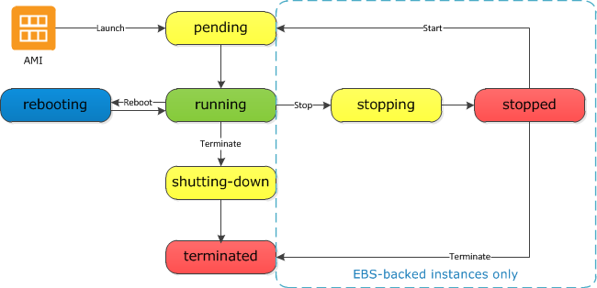
Instance lifecycle
http://docs.aws.amazon.com/AWSEC2/latest/UserGuide/ec2-instance-lifecycle.html

Slide 16
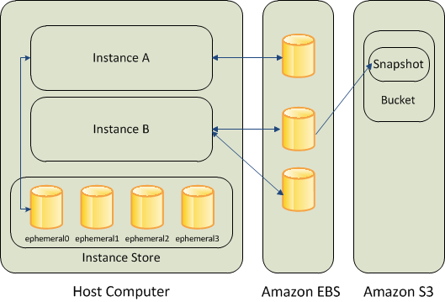
EC2 Root Devices Storage
Root device volume contains the image used to boot the instance.
EC2 instance store and EBS backed AMIs

Slide 17
Instance Store
Physically attached to the host computer
Type and amount differs by instance
Data dependent upon instance lifecycle
Any data on the instance store volumes persists as long as the instance is running, but this data is deleted when the instance is terminated (instance store-backed instances do not support the Stop action) or if it fails (such as if an underlying drive has issues).
Cannot be restored once the instance fails/terminated

Slide 18
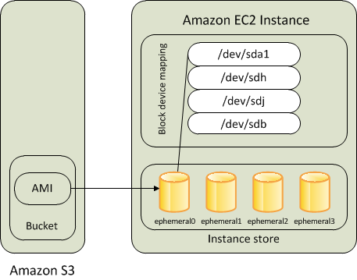

Slide 19
EBS volumes
EBS volumes are automatically replicated within the availability zones (AZ) in which they are created.
Use EBS optimized instances to deliver dedicated throughput between Amazon EC2 and Amazon EBS, with options between 500 and 4000 Mbps, depending on the instance type
Attached to only a single instance
At least 1 GB in size and at most 1 TB
http://docs.aws.amazon.com/AWSEC2/latest/UserGuide/EBSVolumeTypes.html

Slide 20
EBS
Use EBS volumes as primary storage for data that requires frequent updates like the system drive or database application storage etc.
EBS volumes persist independently from the running life of an EC2 instance.
Amazon EBS provides the following volume types:
General Purpose SSD (gp2)
Provisioned IOPS SSD (io1)
Throughput Optimized HDD (st1)
Cold HDD (sc1)
Magnetic (standard)

Slide 21
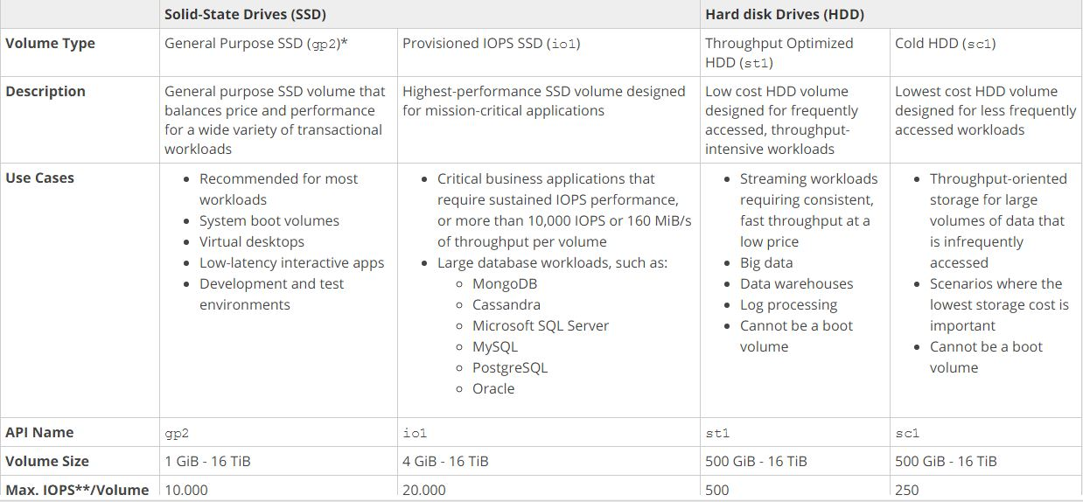
EBS Volumes comparison

Slide 22
EBS Snapshots
Can back up the data on your EBS volumes to Amazon S3 by taking point-in-time snapshots.
Snapshots are incremental backups, which means that only the blocks on the device that have changed after your most recent snapshot are saved.
Active snapshots contain all of the information needed to restore your data (from the time it was taken) to a new EBS Volume

Slide 23
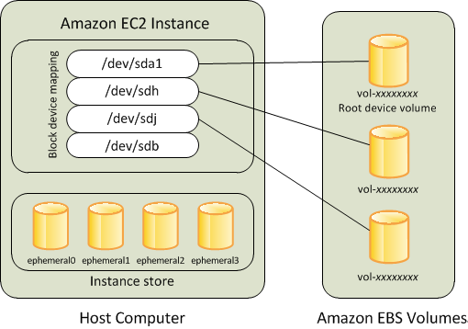

Slide 24
Two Platforms
EC2-Classic
The original release of Amazon EC2
Your instances run in a single, flat network that you share with other customers.
An instance that's launched into EC2-Classic or a default VPC is automatically assigned a public IP address.
EC2-VPC:
The original release of Amazon VPC
Your instances run in a virtual private cloud (VPC) that's logically isolated to your AWS account.
An instance that's launched into a non default VPC can be assigned a public IP address on launch.

Slide 25
Security Groups
You can use security groups to control who can access your instances.
Can create multiple security groups and assign different rules to each group.
Can then assign each instance to one or more security groups, and we use the rules to determine which traffic is allowed to reach the instance.
Can configure a security group so that only specific IP addresses or specific security groups have access to the instance.

Slide 26
Amazon S3 Storage of EC2
Amazon S3 is a repository for Internet data
EC2 uses Amazon S3 for storing Amazon Machine Images (AMIs)
Amazon EC2 also uses Amazon S3 to store snapshots
Objects are the fundamental entities stored in Amazon S3.
Every object stored in Amazon S3 is contained in a bucket.

